Slide 1
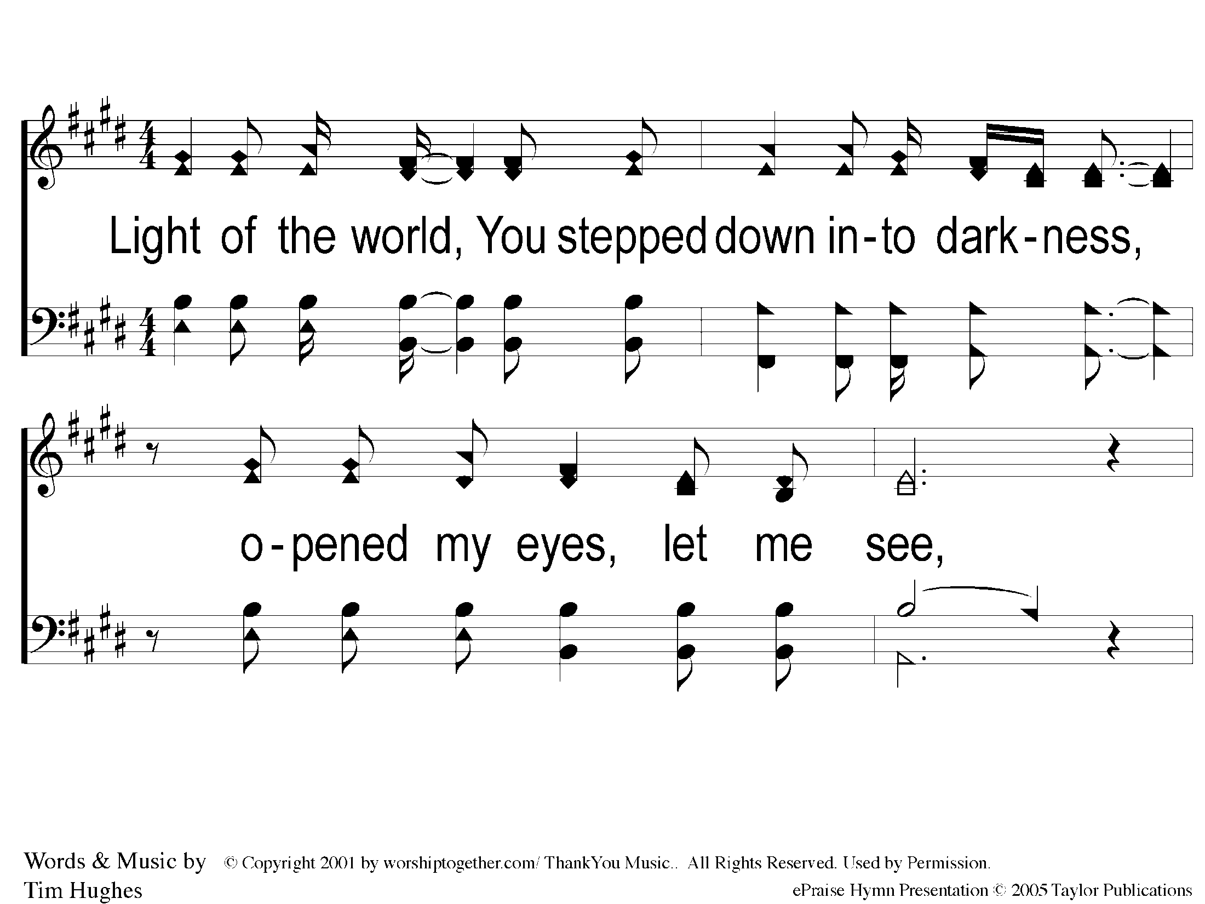
1-1 Here I Am To Worship
Here I Am To Worship

Slide 2
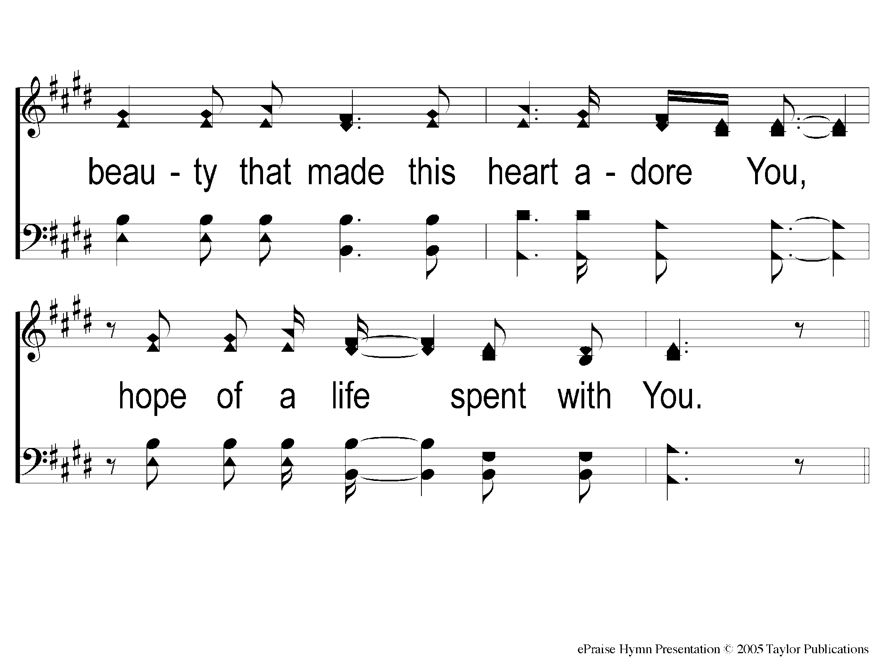
1-2 Here I Am To Worship
Here I Am To Worship

Slide 3
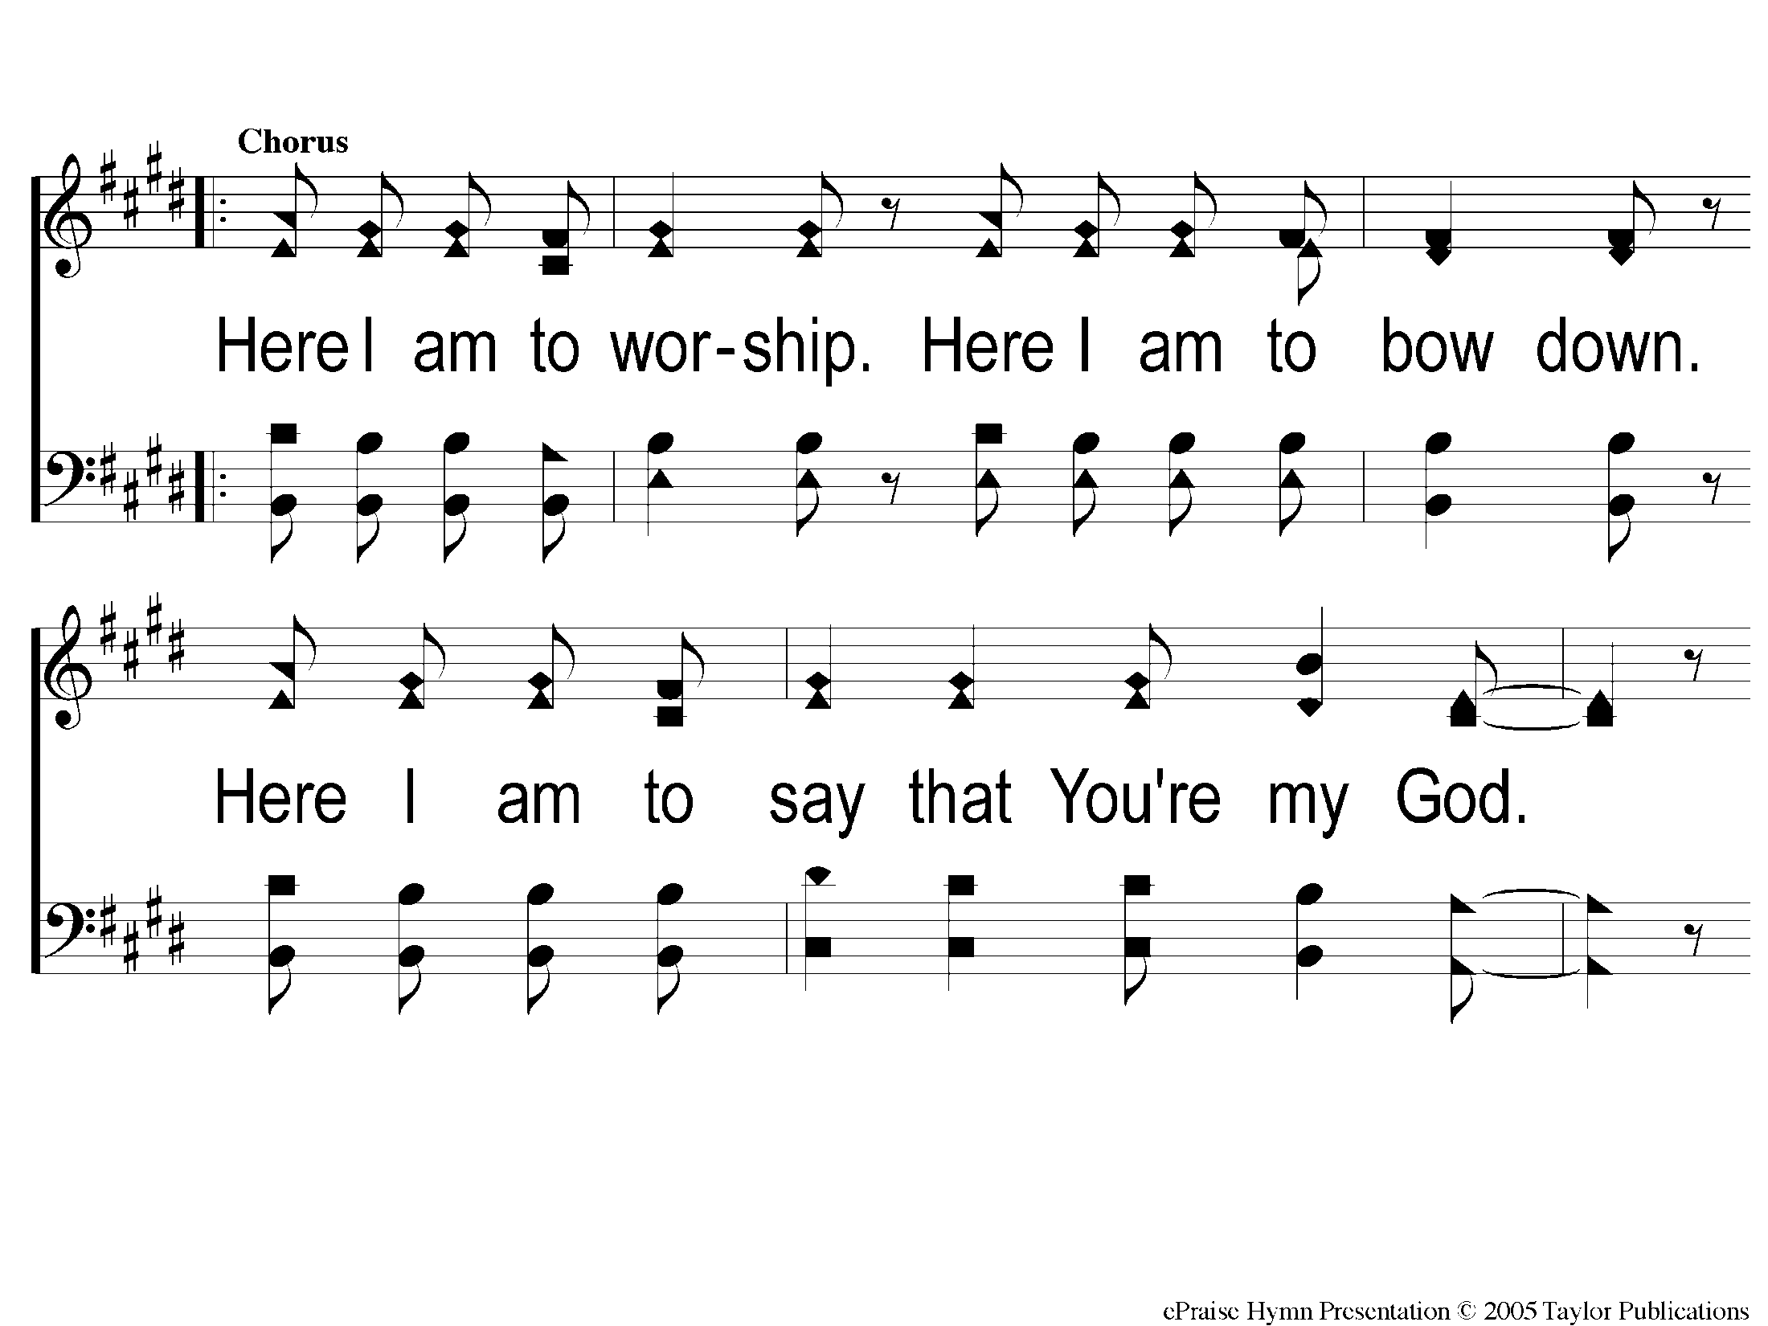
C-1 Here I Am To Worship
Here I Am To Worship

Slide 4
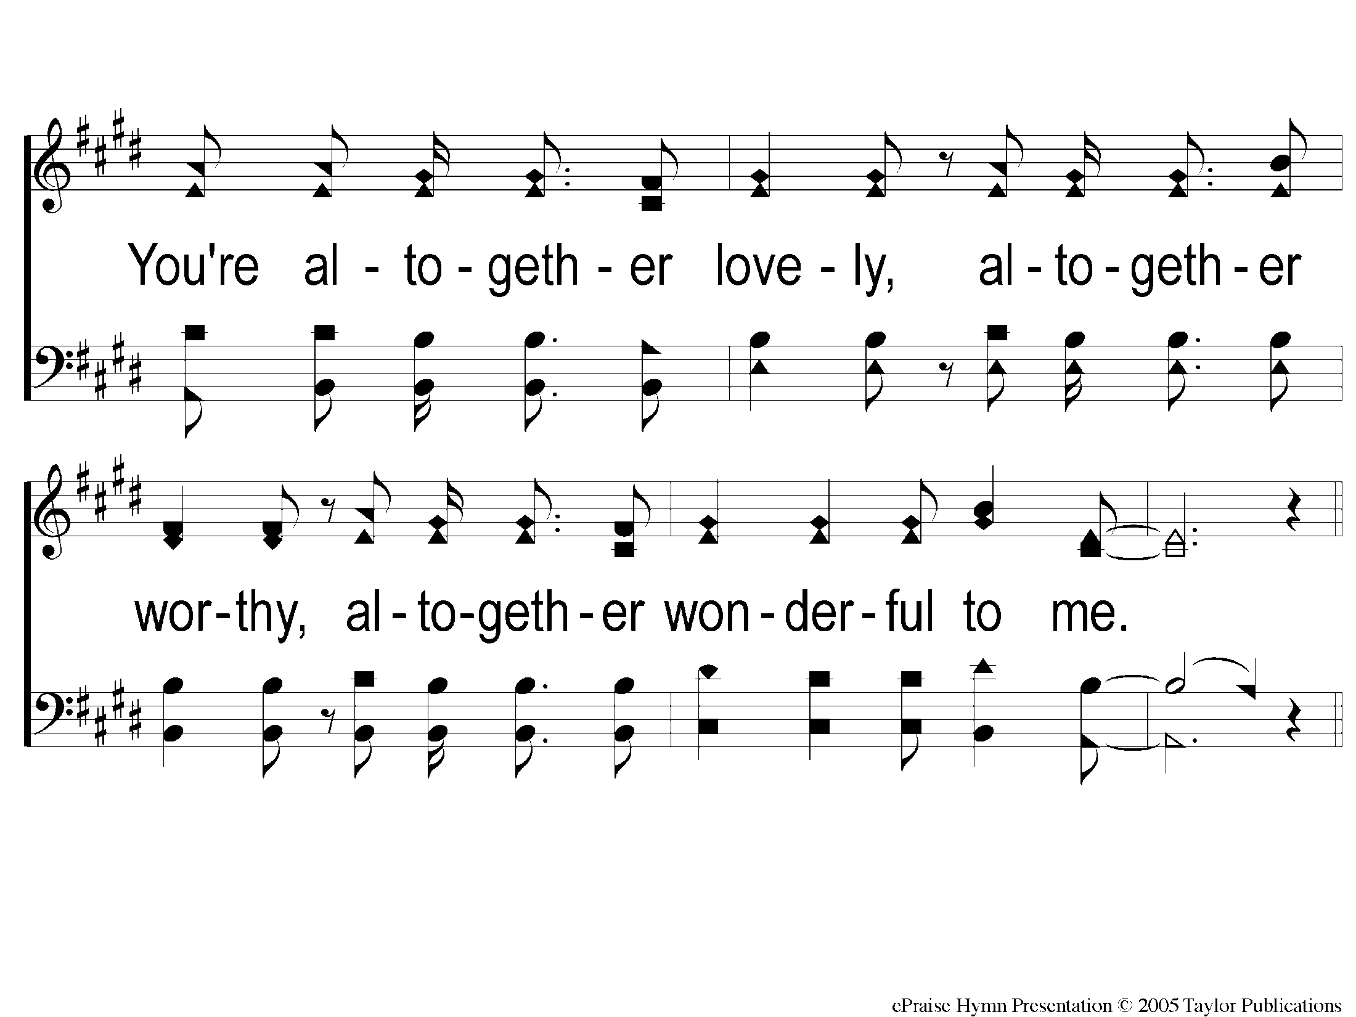
C-2 Here I Am To Worship
Here I Am To Worship

